Slide 1
Tomáš Urych, ESO9 international a.s.

Slide 2
Company Introduction
ESO9 international a.s. Tradition of ESO product from 1991
Head Office: Prague, Czech republic
Company‘s own information systems: IS ESO8 (until 2007)
IS ESO9 (from 1999)
Market ratio: 2,5% (competition: SAP, Navision)
Subsidiary Company: ESO9 Slovakia s.r.o., Žilina, Slovakia
Company‘s implementation partner network
Legislation: CZ, SK, HU, PL

Slide 3
Offer Specification
ESO9 Cloud computing - Support
Our company provides all technological conditions for running, maintenance and development of ESO9 application. Our warranty covers smooth operation of the business application, always in its current version and with its regular mode for creating backups. Our customer is focusing only on his own business and leaving any possible concerns with the operation of ERP to us.
Security
Our company operates our service exclusively on our own servers placed in the countries of the EU, therefore in the states reporting under one judicature. For example in the USA, these companies are required to provide data to the government in accordance with the Patriot Act. This might be in the conflict with the responsibility for personal data protection, that we are bound to against our client according to valid law in Czech republic or in the EU. To secure access to server part of the program from unauthorized use, we are using electronic certificates for the client-side of the program. These certificates are issued by our company.

Slide 4
Offer Specification
Archiving
Full backup is launched every workday at 0:00, every hour is launched a differential backup. History of the daily backup is kept for 5 working days. Data backup is also parallely running in monthly cycles, always on the first working day of the calendar month. History of the monthly backup is stored for 1 calendar month.
Communication
Requirements of users, their inquiries, claims and observations are recorded in the internal system. After entering the requirement to the Hotline, Client will receive automatically generated email message with the given number of the requirement. Current status of processing requirements and their history can be viewed on the website at the URL address of the provider http://podpora.eso9.cz. Our company provides remote (distance) support for clients working on their hardware devices and using tools like TeamViewer or MS LYNC.
Language modifidations
ESO9 Start is as standard being supplied including translation dictionaries. One of them is also in English. In case of customers need, it is possible to adjust several specific expressions.

Slide 5
Offer Specification
Implementation procedures and a support while implementing
We expect that the implementation of the work will be performed by our subsidiary ESO9 Slovakia Ltd.- a team of workers who are in charge of your Slovak application.
Within the work there will be transfered all the necessary adjustments for the application‘s adaptation, setting communication interface, training and increased supervision.
We expect synergy when defining the Data File and required reports and reconciliations. Term of realization
All your requirements are realizable in IS ESO9. We are prepared to launch the work as was your required schedule (expected within one month from the date the order was recieved).
Price–contracted (Billing for ESS - contract prices )
We appreciate our existing cooperation, as this was reflected in the creation of this quotation
Price of monthly fee for ESO9 to aggregate data from different applications and cloud access licenses (10 users) | 350 EUR per month
Setting the application, implementation arrangements | 3999 EUR

Slide 6
Offer Specification
Services reflected in the price for the implemantation of application - Multisite mode operation - Generating access licenses for individual users - Creating a repository for files from applications outside ESO 9 - Creation of standard import file from other applications - Support and creation of overview summary output for a required companies - Setup for the development of planning for the entire holding - Possibility of extension for other applications

Slide 7
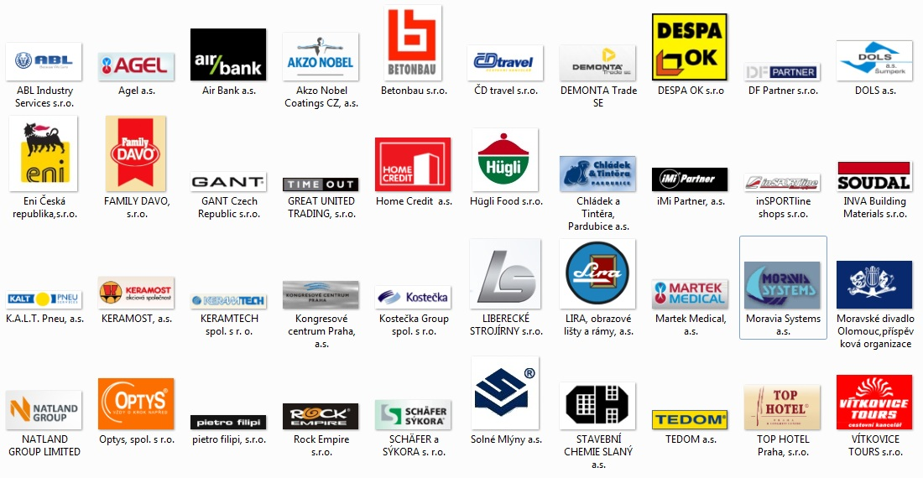
Selected references

Slide 8
Thank you for your attention…

