Slide 1
ESO9 Technology
Tomáš Urych, ESO9 international

Slide 2
ESO9 architecture
Cross-platform Client
(any OS, web browser, HTML5)
HTTP
TCP/IP
LAN (TCP/IP)
Database Server
(Windows Server 2016‑2022, SQL Server 2019‑2022)
Application Server
(Windows Server 2016‑2022, IIS, .NET Fw)
Mobile Client
(Tablet OS, web browser, HTML5)
HTTP
TCP/IP

Slide 3
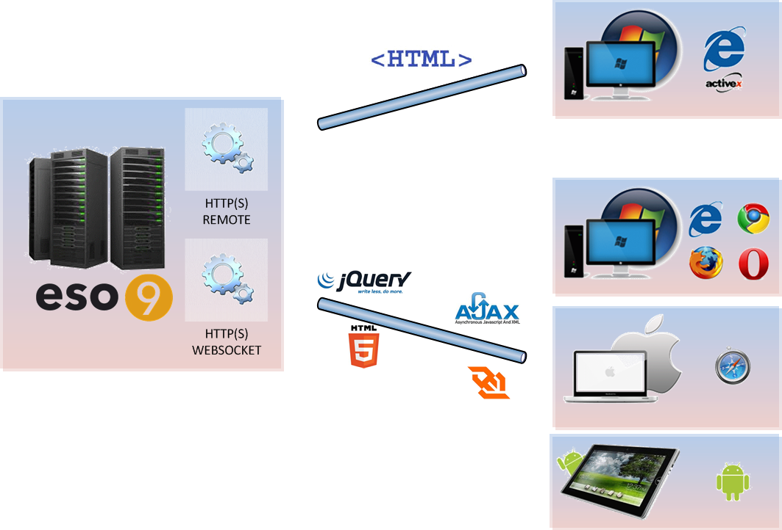
Obecný klient ESO9

Slide 4
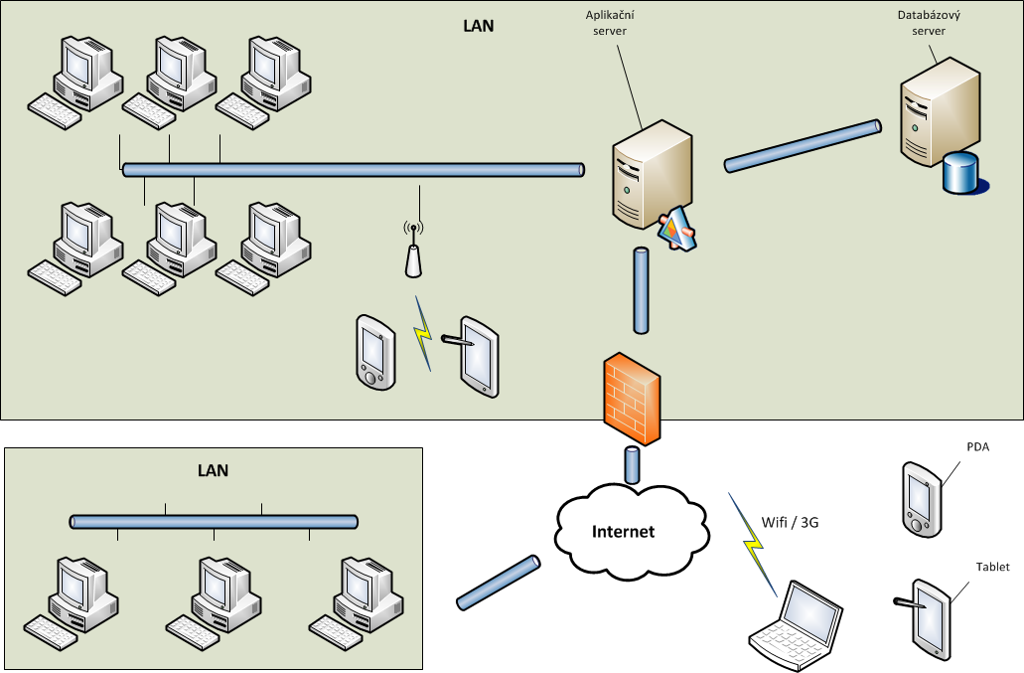
System infrastructure

Slide 5
System infrastructure
Internet
VPN

Slide 6
System infrastructure
DMZ
Internet

Slide 7
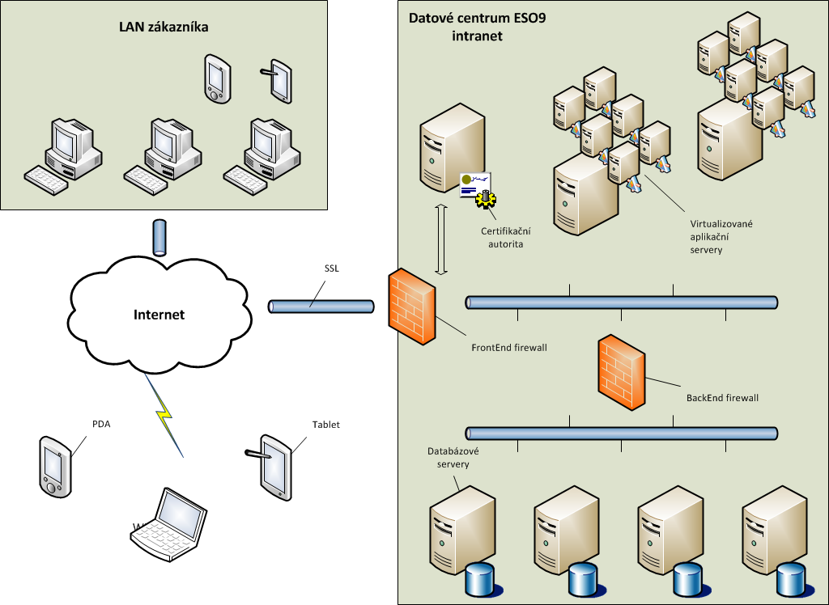
System infrastructure (ESO9 cloud)

Slide 8
HTTPS
Internet
Personal certificate
Network Load Balancer
ESO9 cloud
Certification authority
App.servers
DB servers

Slide 9
Technology ESO9
Web browser
Client
Universal Client ESO9
Support Service
IIS
Application Server
Server AddIn
Application server
.NET Framework
SQL Server
Database
OLAP
Reporting
Database Server

Slide 10
Technology components
Client
Application Server
Database Server
IIS
Universal Client
.NET Service
MS SQL
APP SRV
SuppSvc
ESO9LIB

Slide 11
Page creation process
Application server
Client
IIS
Invoice
ESO9SVC
Invoice
Read template
Parse template (HTML)
Database server
Read data
MS SQL
Assemble page (HTML)

Slide 12
User Authentication
NT / Windows authentication
Safest way to verify user over Internet
Client certificates
Applicable on Internet / intranet
Forms authentication
Local Network support only
Need to combine with HTTPS protocol
No username/password is required
Commercial or custom certificates
Username/password input is not comfortable for users

Slide 13
User Authentication
Google Accounts
New standard for authentication on web
WebAuthn
Suitable for Internet + companies without centralised inftrastructure
Strong Authenticators (Windows Hello, Apple ID, USB token)
Safe authentication on Internet
Pairing user accounts based on e-mail addres
No credentials, no passwords, no Server-Side Credentials Storage
2FA, biometric

Slide 14
Multilingual environment
Language set on app. server
Language set on application
Language set on user

Slide 15
Multilingual environment
Into which languages ?
Page templates
Which parts of the application are translated?
Database server error and information messages
Reports
Slovak
English
Application server error and information messages
Client error and information messages
Hungarian
German
Polish
… number of translation is a tax for flexible architecture ESO9

Slide 16
ESO9 import / export
Custom formats
IS DOC (accounting documents)
Standard formats
EDI (accounting and stock documents)
Direct database access (tables, views)
XML
XLS
CSV, TXT, PDF, HTML
Automated / manual running
MS SQL Server Integration Services
Custom mechanism
Direct connection through web / REST API services

Slide 17
ESO9 import / export
JSON API
Can define import/export of any data structures by implementation
Universal REST API
Designed primarily for analytical tools
Simple and quick R/O API provide data in JSON format
Online connections from Excel, Power BI, Tableau and more
Any custom file format defined by customer
Implemented as a Server Addin or CLR library
With / without communication infrastructure

Slide 18
Thank you for your attention

